Slide 1
Sentence Level Recurrent Topic Model: Letting Topics Speak for Themselves
Fei Tian Bin Gao
University of Science and Technology of China Microsoft Research
tianfei@mail.ustc.edu.cn bingao@microsoft.com
Di He Tie-Yan Liu
Microsoft Research Microsoft Research
dihe@microsoft.com tyliu@microsoft.com

Slide 2
Background
Most topic models take the bag-of-words assumption
bring computational convenience
sacrifice the characterization of sequential properties
sacrifice topic coherence between words belonging to the same sentence
For example:
the department chair couches offers
the chair department offers couches

Slide 3
Background
Existing works:
sentence level topic models:
all the words in a sentence to share the same topic
the transition between sentence topics to be Markovian
words within the same sentence are still exchangeable
embedding based neural language model:
consider local context (including its preceding words within a fixed window, topic and document)
introduce limited sequential dependency
no explicit coherence constraints

Slide 4
Method
Sentence Level Recurrent Topic Model (SLRTM)
words in the same sentence to share the same topic
the generation of a word to rely on the whole history
use Recurrent Neural Network to model such a long term dependency
advantages:
model the document generation process more accurately
construct new natural sentences with a given topic

Slide 5
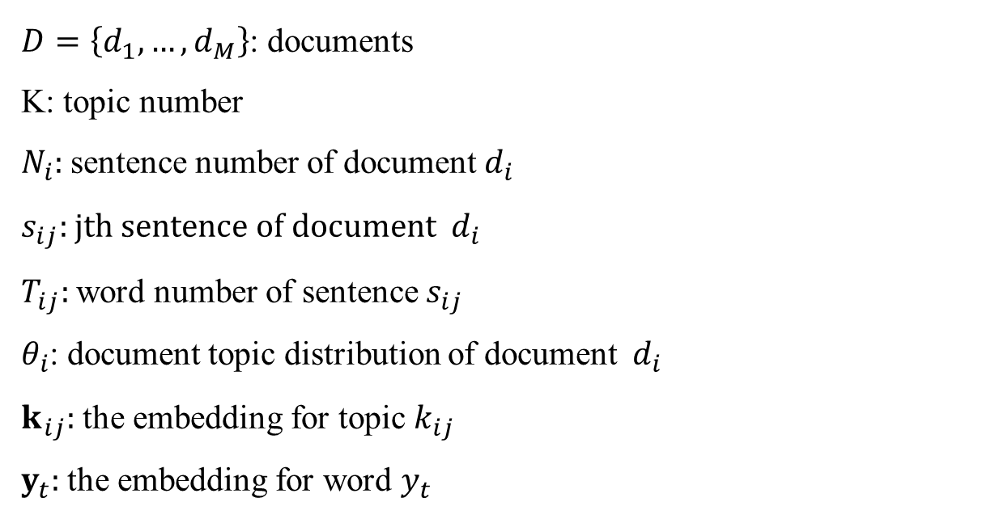
Method
Notation:
$D=\left\{d_{1},…,d_{M}\right\}$: documents
K: topic number
$N_{i}:$ sentence number of document${ d}_{i}$
$s_{ij}:$ jth sentence of document ${ d}_{i}$
$T_{ij}:$word number of sentence $s_{ij}$
$θ_{i}$: document topic distribution of document ${ d}_{i}$
$k_{ij}:$ the embedding for topic $k_{ij}$
$y_{t}:$ the embedding for word $y_{t}$

Slide 6
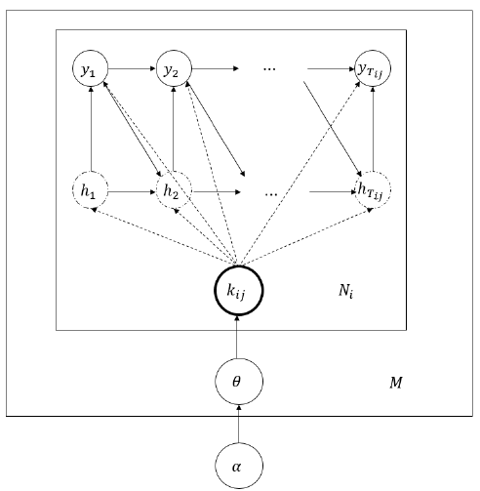
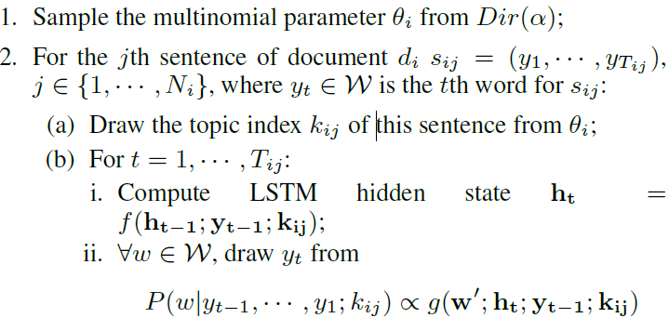
Method
The generative process
For each document $d_{i}:$

Slide 7
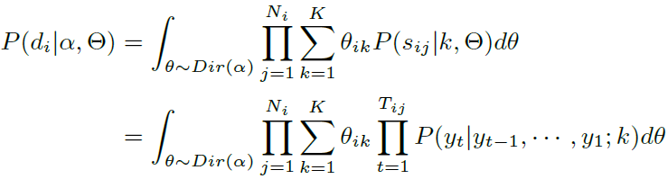
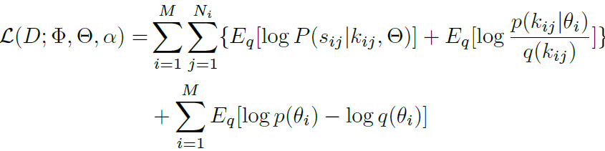
Method
the probability of observing document:
the variational lower bound of the data likelihood:

Slide 8
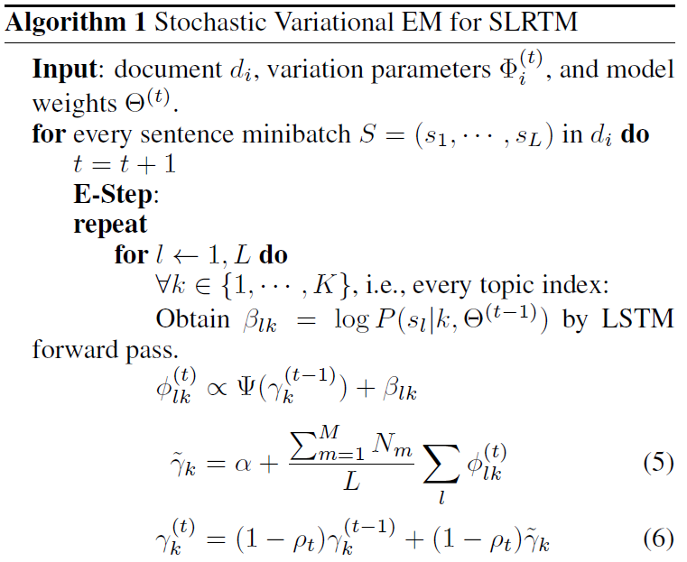
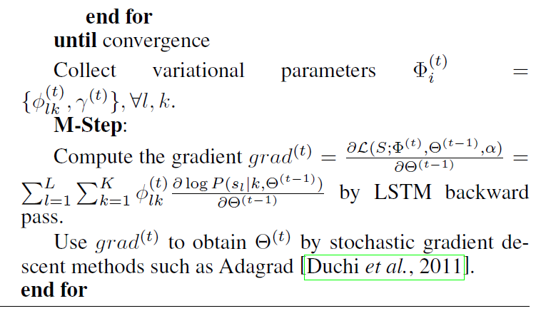
Method

Slide 9
Experiments
 Datasets：
 20Newsgroup：18,845 emails categorized into 20 different topical groups, 11,314 training documents and 7,531 test documents
 Wiki10+：11,164 training set and 6,161 testing set
 Baseline：
 LDA：the classical topic model
Doc-NADE: a neural network based topic model
HTMM: sentence level Markov transitions
GMNTM : models the order of words within a sentence by a feedforward neural network

Slide 10
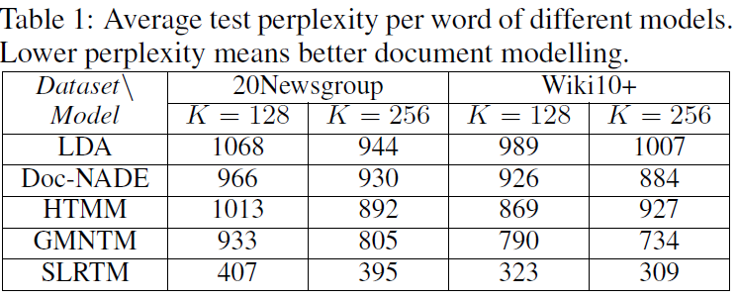
Experiments
 SLRTM consistently outperforms the baseline models
Models that consider sequential property within sentences (i.e., GMNTM and SLRTM) are generally better than other models
LSTM is much better in modelling such a sequential dependency than standard feed-forward networks

Slide 11
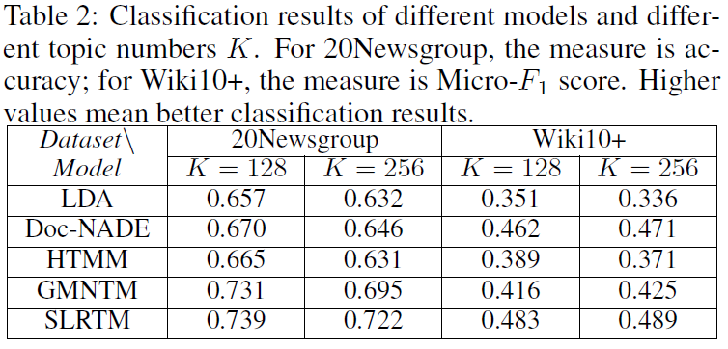
Experiments
 SLRTM is the best model under each setting on both datasets.
Embedding based methods generate better document representations than other models

Slide 12
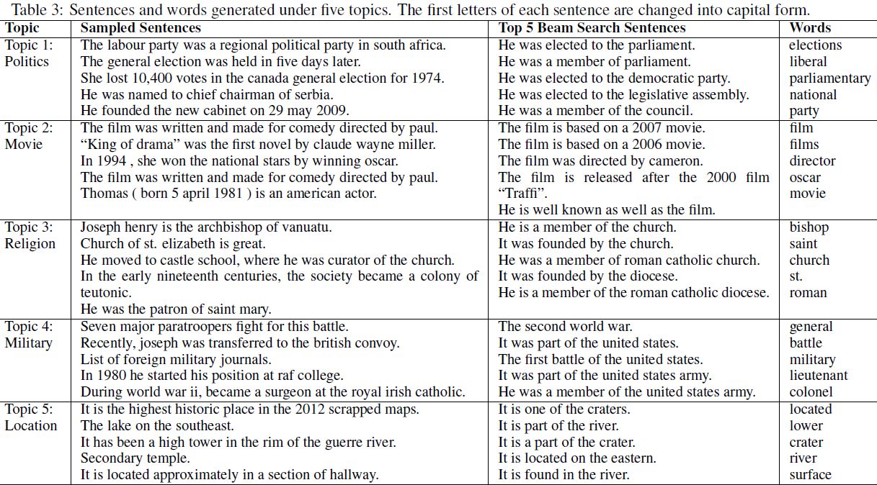
Experiments

